Slide 1
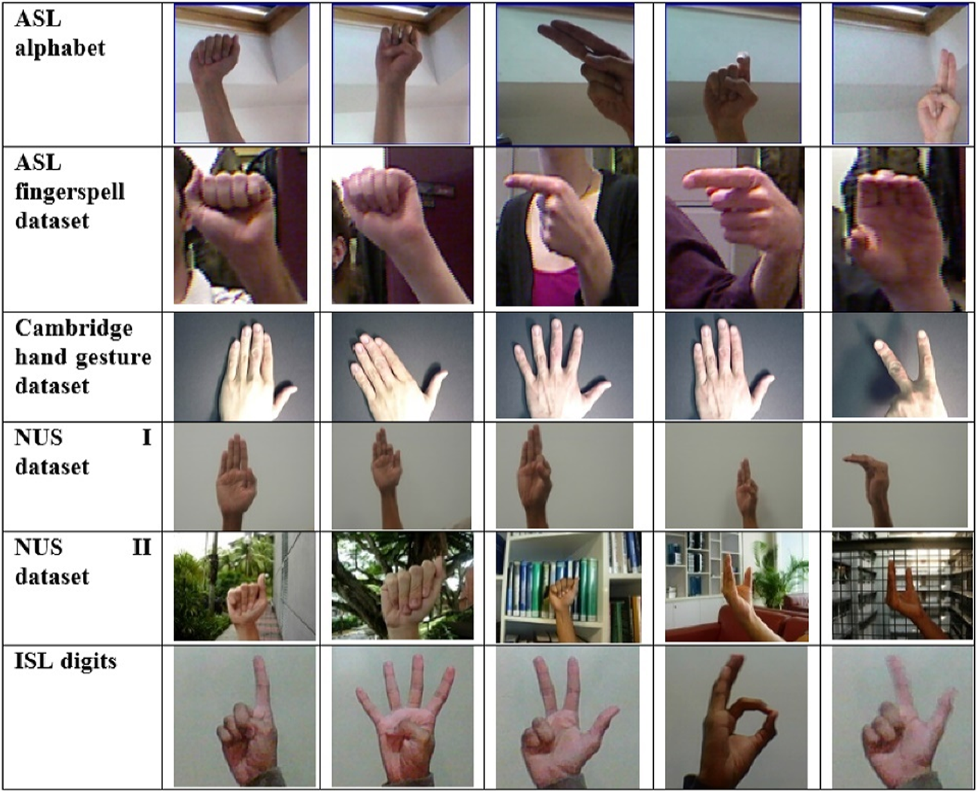




Graduation Project
Sign Language
Detection System
Using AI
SUPERVISOR
Dr. Marah Qassas
TEAM MEMBERS
Loay Alatar
ID: 202210843
Computer Vision & Machine Learning Solution
Asaad Abo Ateyeh
ID: 202120257
Alaa Asfa
ID: 202110530
Jadara University
Faculty of Information Technology

Slide 2
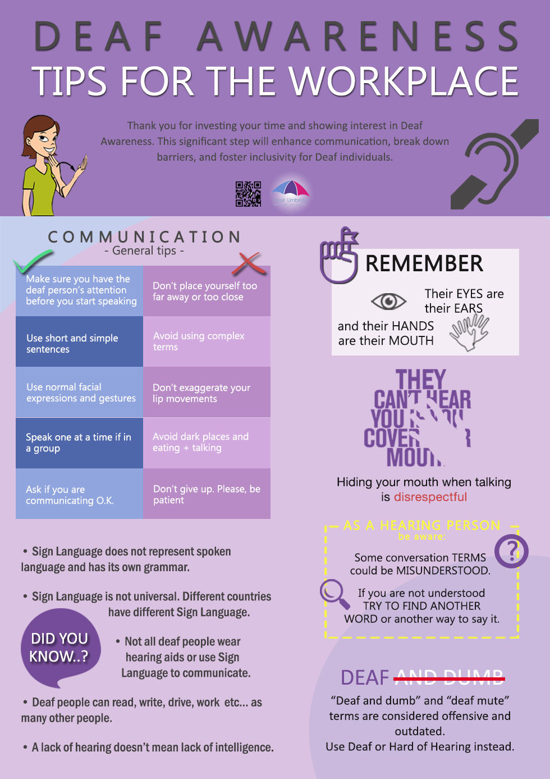






The Communication Gap
The Barrier
Deaf and mute individuals rely on sign language, which the majority of society does not understand.
Consequences
Social isolation and exclusion
Difficulties in education, healthcare, and daily services
Misunderstandings and discrimination
Limitations of Existing Solutions
Expensive sensor gloves
Uncomfortable to wear
Require maintenance and calibration
Restrict natural hand movement
"Their eyes are ears, their hands are mouths."

Slide 3
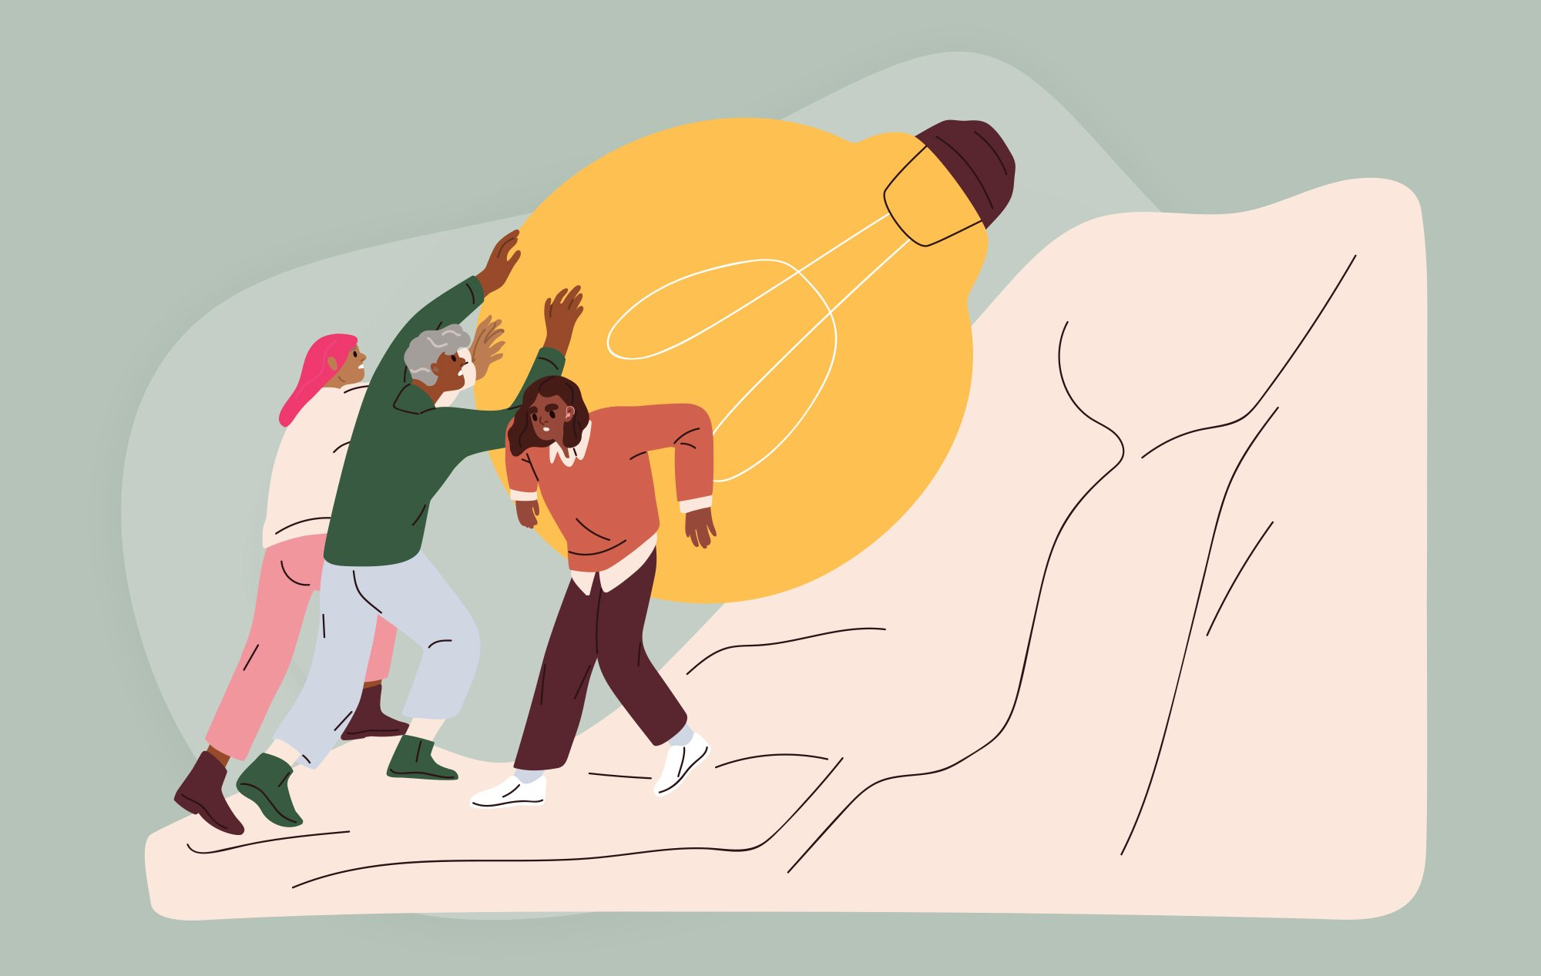




Goals & Purpose
Improve Communication
Real-time translation of hand gestures into readable text
Social Integration
Enable deaf/mute individuals to express needs and emotions effectively
Accessibility & Equality
Affordable tech-based solution without specialized hardware
User-Friendly
Easy-to-use desktop interface with low computational costs
Bridging gaps, connecting lives

Slide 4
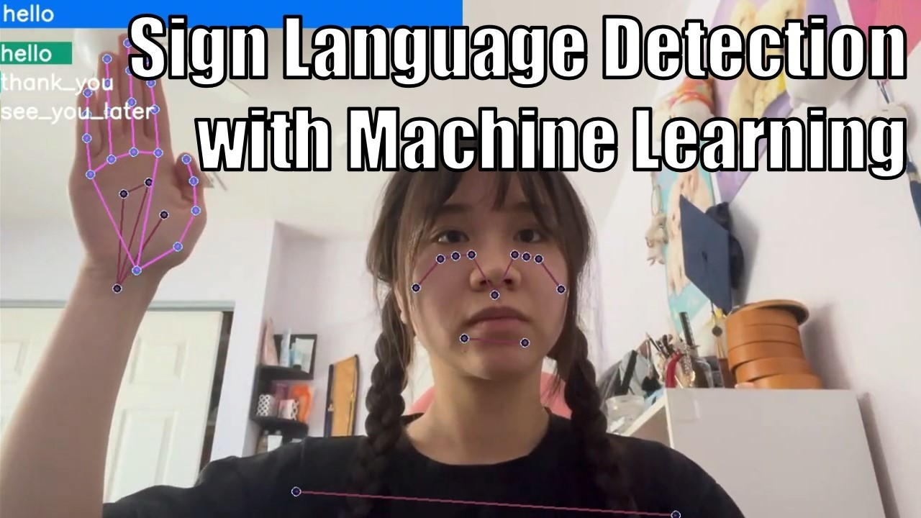





Proposed Solution: Camera-Based AI
Camera Capture
01
Standard webcam captures live video feed
Hand Detection
System detects hands and extracts landmarks (key points)
02
ML Classification
03
Machine Learning model classifies the gesture
Display Result
04
System displays the extracted words as text in a text box
Key Benefit
Eliminates need for physical sensors — cost-effective and portable
Real-Time Detection
Camera-based AI solution

Slide 5

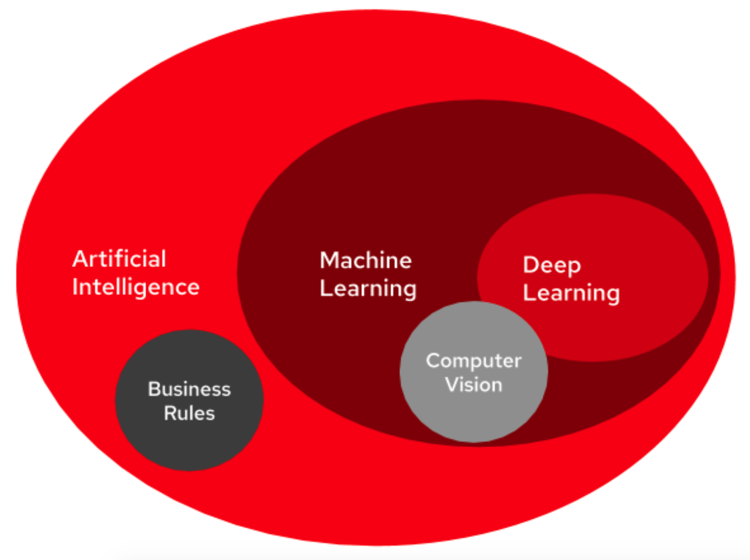

Tools & Algorithms
Programming Language
Python ,SQL
Computer Vision
OpenCV: Video capture & image processing
MediaPipe Hands: 21 hand landmarks extraction
Machine Learning
Scikit-learn: ML classification library
Random Forest: High accuracy gesture classifier
User Interface
Tkinter: Desktop GUI (Login, Menu, Training)

Slide 6
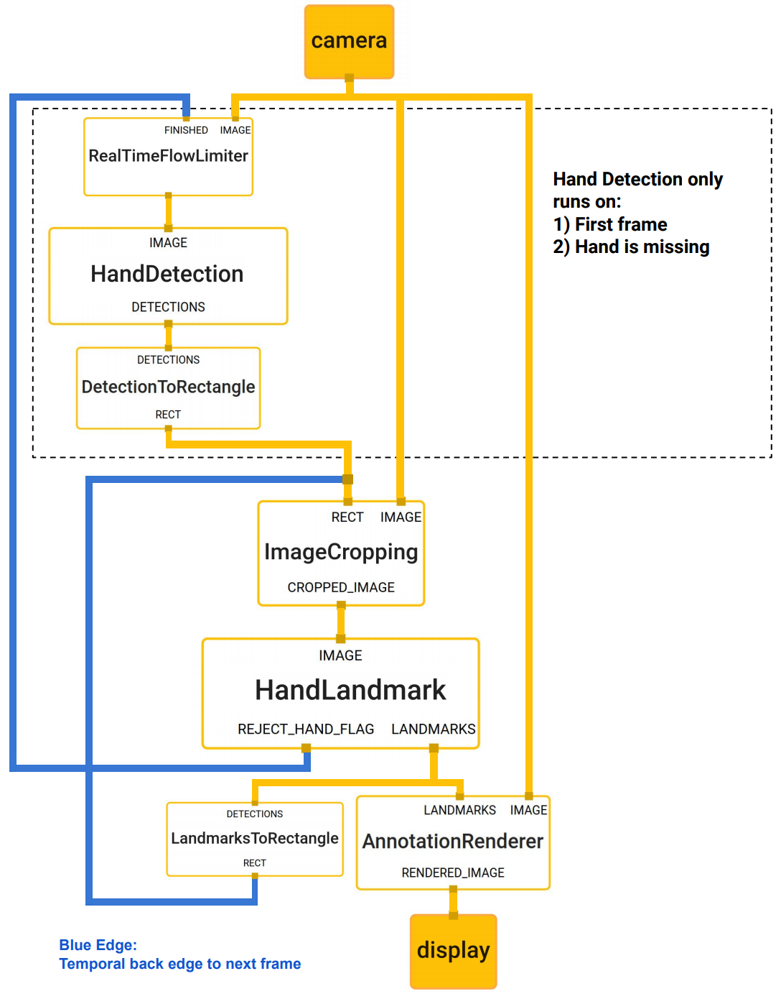


How It Works
Input
Live video feed from device camera
Processing
Hand Detection:
MediaPipe identifies hand
Feature Extraction:
21 x,y coordinates normalized
Classification:
Random Forest predicts gesture
Output
Display predicted text with bounding box
Real-Time Processing Pipeline

Slide 7
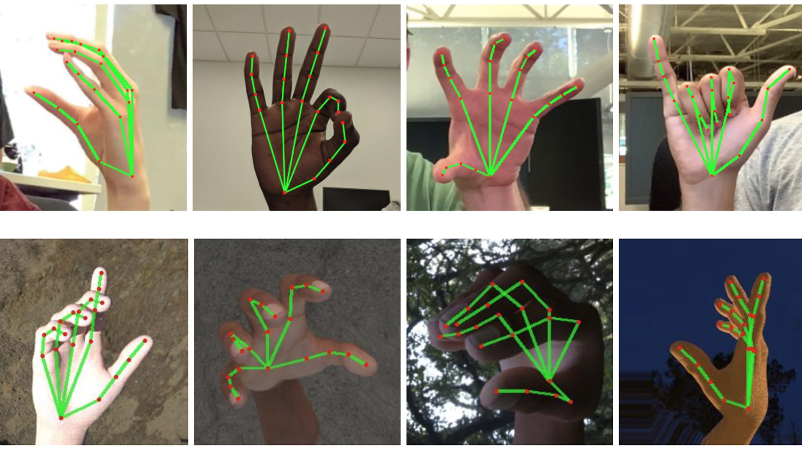


Core Functionality
Landmark Detection
MediaPipe uses palm detector + landmark model to track 21 key 3D points on hand
Stability Features
Smoothing technique with prediction buffering prevents flickering results
Training Pipeline
• Users add new gestures via GUI
• Automatic data collection
• Feature extraction & model retraining
21 Hand Landmarks Tracking

Slide 8


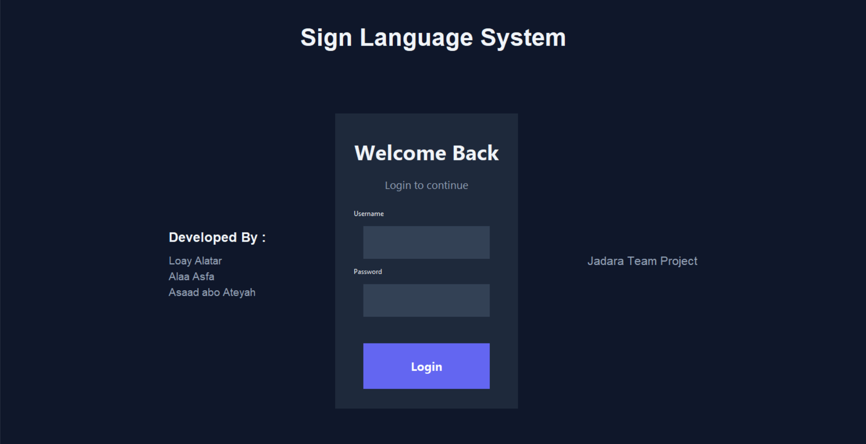



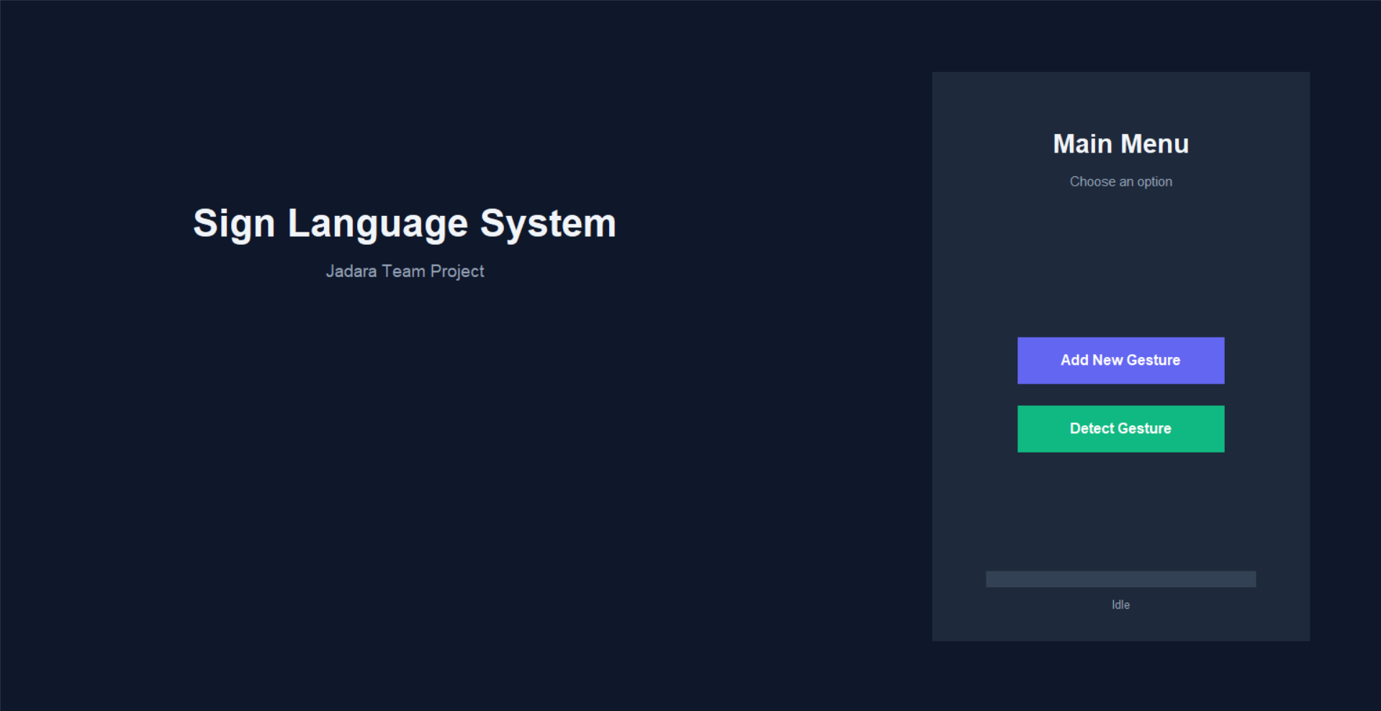
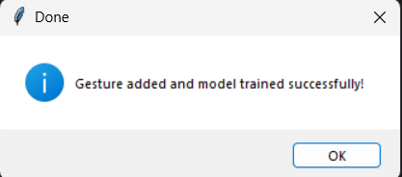
System Interface Showcase
01
Login Interface
Training Progress
03
Main Menu
04
Success Confirmation
02

Slide 9
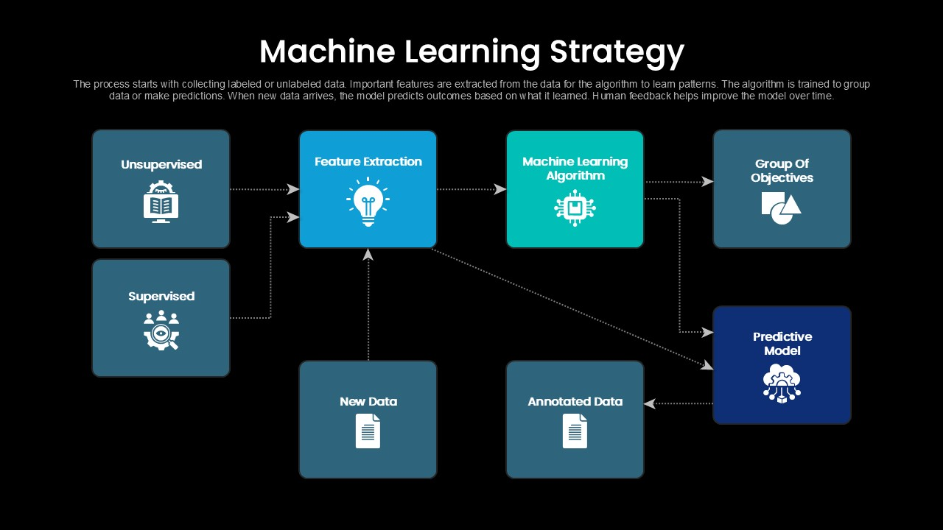



Ensuring Accuracy
Data Collection
• 100 frames/5 seconds per gesture
• Diverse dataset: different hand sizes, skin tones, lighting
Preprocessing
Noise reduction & normalization using OpenCV
Evaluation Metrics
• Accuracy: Correct predictions percentage
• Latency: Real-time responsiveness
• Precision & Recall: Cross-validated
Performance Evaluation

Slide 10

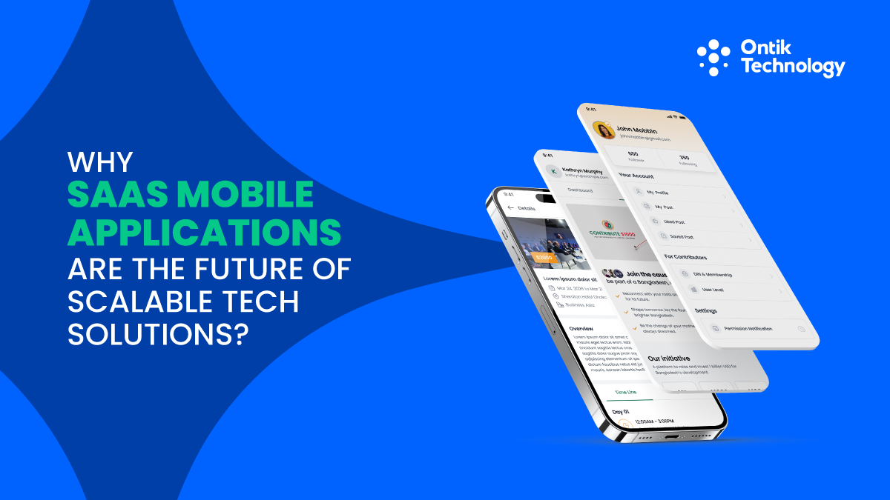



Future Work
Mobile Deployment
Develop mobile app using Flutter/React Native for portability
Web Application
Create browser-based version for wider access
Expanded Vocabulary
Increase dataset to cover larger variety of words and signs
Audio Output
Improves text-to-speech features for to-way communication
Future Deployment Platforms

Slide 11
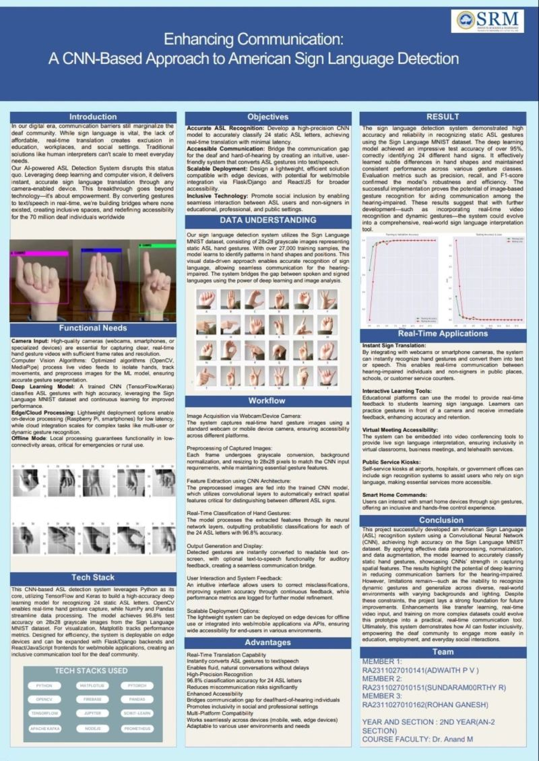




Summary
Successfully developed AI-driven assistive tool
Provides low-cost, scalable, reliable alternative to sensor gloves
Bridges communication gap between hearing/speech-impaired community and society
Demonstrates high performance using MediaPipe & Random Forest in real-time
Thank You!
Sign Language Detection System

